Slide 1




PROJECT TITLE:
AI BASED MICROPLASTIC DETECTION AND VOICE AWARE SYSTEM
TEAM MEMBERS:
Lakshmi Sri M[211423104325]
Lalitha M [211423104326]
DEPARTMENT: Computer Science and Engineering
GUIDE: Mrs.Padamapriya
PROJECT COORDINATOR: Dr. Sangeetha K , Dr.Valarmathi.K
BATCH: C7
SDG FOCUS:
SDG 6 – Clean Water and anitation
SDG 14 – Life Below Water
SDG 13 – Climate Action

Slide 2


ABSTRACT
THE CHALLENGE: Microplastic pollution in water is harmful and hard to detect with traditional methods that are expensive and slow.
The presence of these tiny plastic particles in water supplies poses serious risks, necessitating accurate, rapid, and accessible detection methods.
PROJECT OBJECTIVE: To create an AI-powered system that quickly detects microplastics in water images and alerts users via voice, making water safety monitoring easy and accessible.
WHY IT MATTERS:
Clean water is essential for health.
Early detection helps reduce risks from microplastics and encourages responsible environmental practices.

Slide 3

SOCIAL RELEVANCE
SOCIETAL BENEFIT:
Protects public health by detecting hidden microplastic pollution in water.
Enables communities to monitor water safety in real time.
Empowers timely interventions to reduce exposure to harmful microplastics.
LINKED SDG:
SDG 6: Clean Water and Sanitation
SDG 12: Responsible Consumption and Production
REAL-WORLD RELEVANCE:
Provides accessible, rapid, and cost-effective water quality screening.
Facilitates awareness and action to reduce plastic pollution impact.
Improves health outcomes by preventing contaminated water use.

Slide 4

LITERATURE SURVEY
Traditional microplastic detection relies on filtration, microscopy, and spectroscopy—methods that are slow, costly, and require experts.
Recent studies show deep learning (CNN, YOLO) can automate microplastic identification with high accuracy in images.
Mobile-based AI tools and smartphone microscopy have emerged, but often lack rapid, user-friendly interfaces.
Most literature highlights the need for low-cost, scalable, and real-time detection accessible to non-experts.
Our work builds on these advances to create a practical, accessible solution for community and environmental use.

Slide 5
PROBLEM STATEMENT
Microplastics—tiny plastic particles less than 5 mm—are increasingly found in water sources, posing risks to both environmental and human health.
Traditional detection methods are slow, require specialized equipment, and are inaccessible for real-time, widespread monitoring.
There is a need for a rapid, accurate, and user-friendly system to detect microplastics in water and alert users quickly, supporting timely interventions for water safety.

Slide 6

HARDWARE & SOFTWARE SPECIFICATION
Hardware:
Laptop/PC with i5 or higher processor
Minimum 8GB RAM
Webcam/smartphone camera
Software:
Windows/Linux OS
Python 3.8+
TensorFlow, Keras (Deep Learning)
OpenCV, Pillow (Image Processing)
Streamlit (User Interface)
pyttsx3 (Voice Alert)

Slide 7
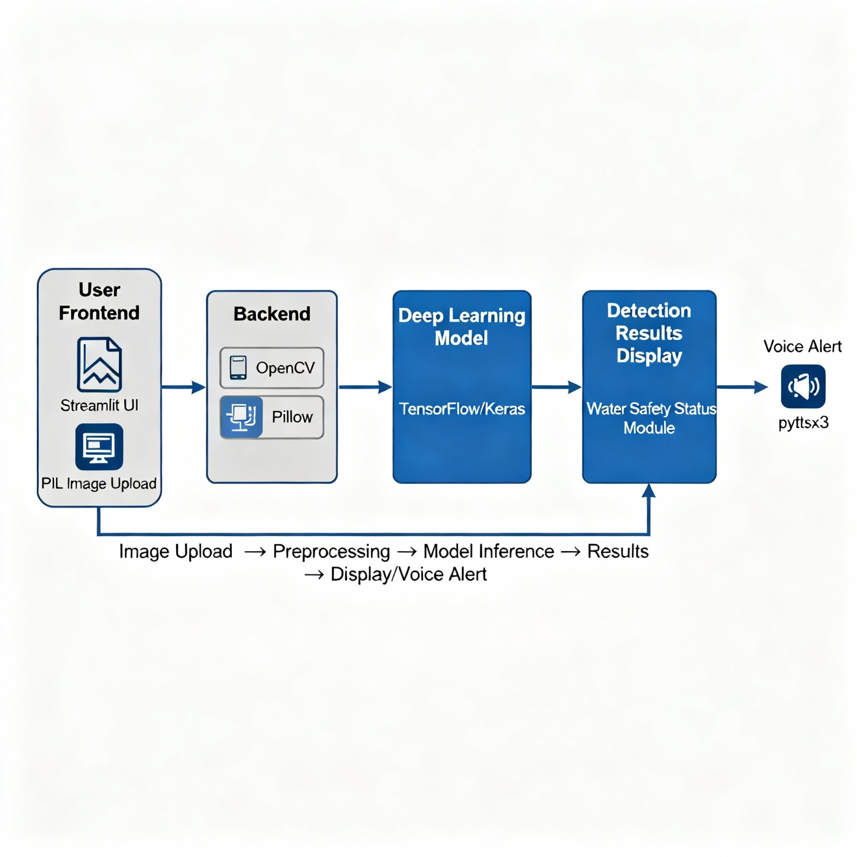
SYSTEM ARCHITECHTURE DIAGRAM

Slide 8

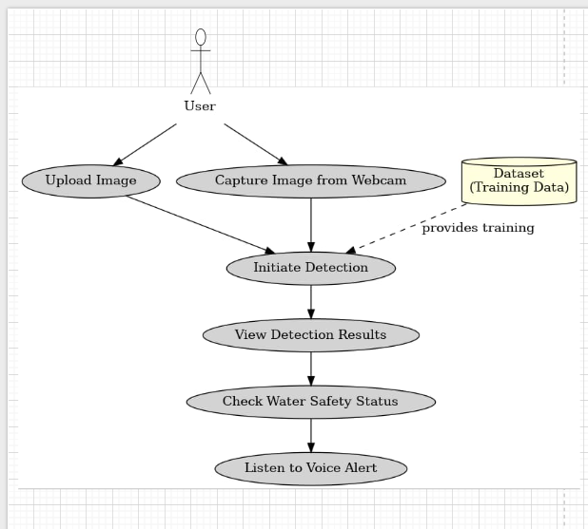
USE CASE DIAGRAM

Slide 9
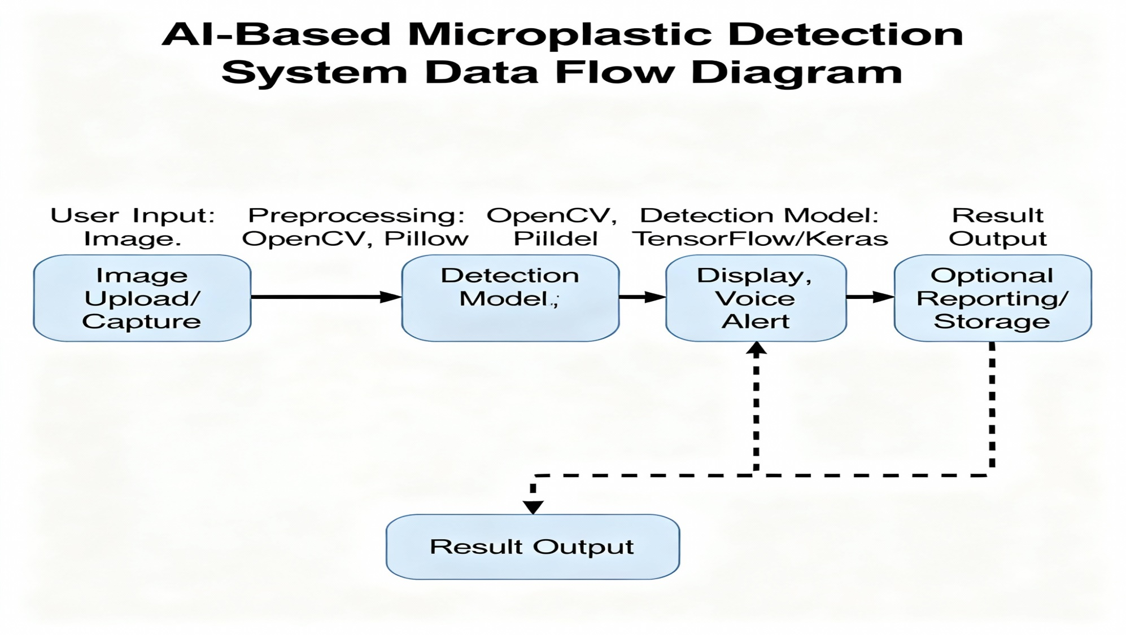
DATA FLOW DIAGRAM

Slide 10
MODULES
1. User Interface Module Allows users to upload water sample images or capture them via webcam for analysis.
2. Image Preprocessing Module Processes input images using OpenCV and Pillow for better feature extraction.
3. Data Augmentation Module Performs rotations, flipping, and scaling to enrich the training dataset and improve model robustness.
4. Detection & Classification Module Runs the preprocessed image through a trained CNN model (using TensorFlow/Keras) to detect and classify microplastics.
5. Results Display & Voice Alert Module Shows detection results visually and delivers a voice alert using pyttsx3.
6. Performance Metrics Module
Computes and reports accuracy, precision, recall, and F1-score

Slide 11
ALGORITHM & METHODOLOGY
ALGORITHM USED:
Convolutional Neural Network (CNN) Used for detecting and classifying microplastics from water sample images.
METHODOLOGY:
Image dataset collected and preprocessed using OpenCV & Pillow.
Noise reduction, resizing, and normalization applied for feature clarity.
Data augmented with rotation and flipping to improve model accuracy.
CNN model trained using TensorFlow/Keras with optimized hyperparameters.
Tested on unseen images; water safety status predicted through Streamlit UI.
pyttsx3 generates voice alerts for detection results.

Slide 12
MODEL TESTING
Process:
Loaded the trained deep learning model (microplastic_model.pkl).
Tested the model with a separate dataset of water images not used during training.
Compared predicted labels with actual microplastic classes.
Calculated accuracy, precision, recall, and F1-score to evaluate performance.
Result :
Metric | Value
Training Accuracy | 88%
Testing Accuracy | 85%
Model File | microplastic_model.pkl

Slide 13
PERFORMANCE EVALUATION
Performance Metrics:
Accuracy: 85%
Precision: 0.86
Recall: 0.85
F1 Score: 0.85
📈 The model demonstrates strong and consistent performance in detecting microplastics across all tested water samples.
High precision and recall values indicate reliable identification and minimal misclassification even with variations in sample appearance and background.
This confirms the system’s effectiveness for real-world environmental monitoring.

Slide 14
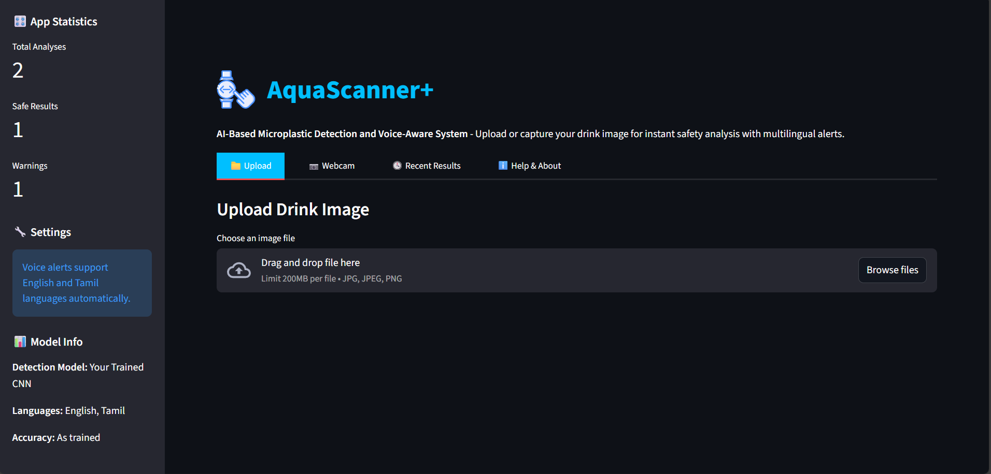
SCREENSHOTS
User Interface

Slide 15
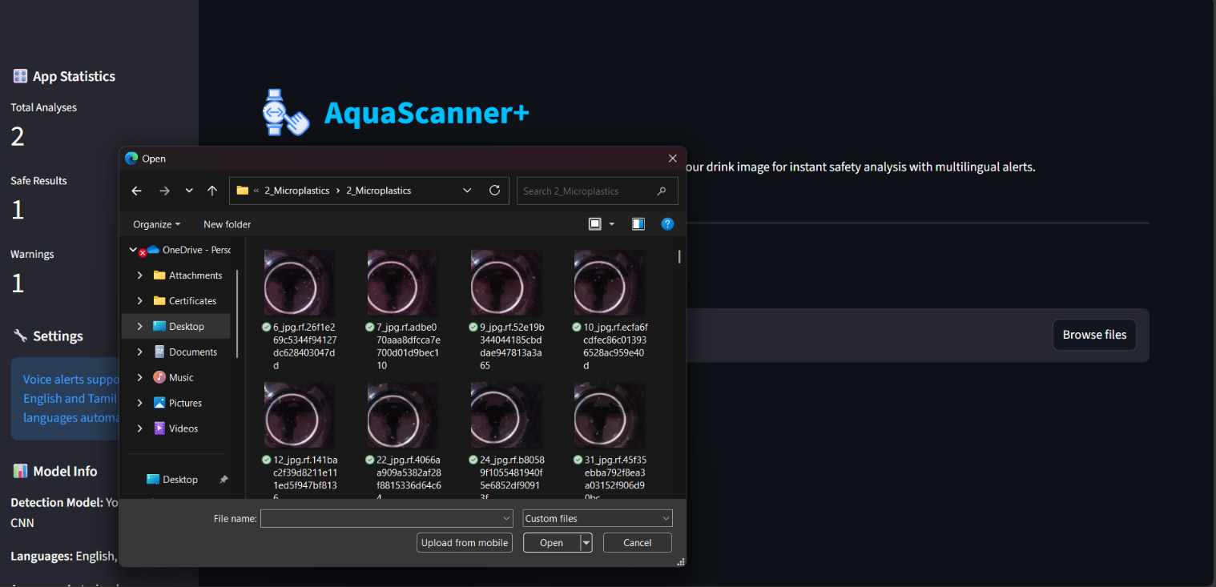
BROWSE IMAGE

Slide 16
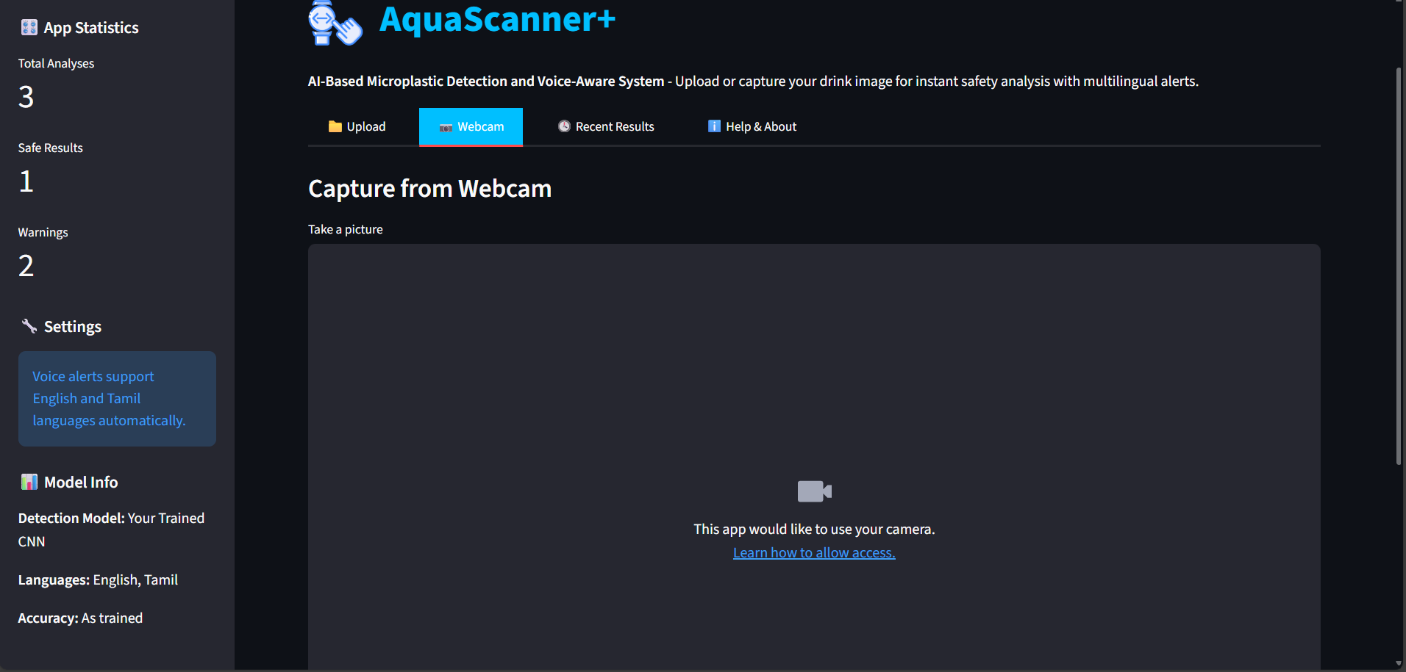
WEBCAM ACCESS

Slide 17
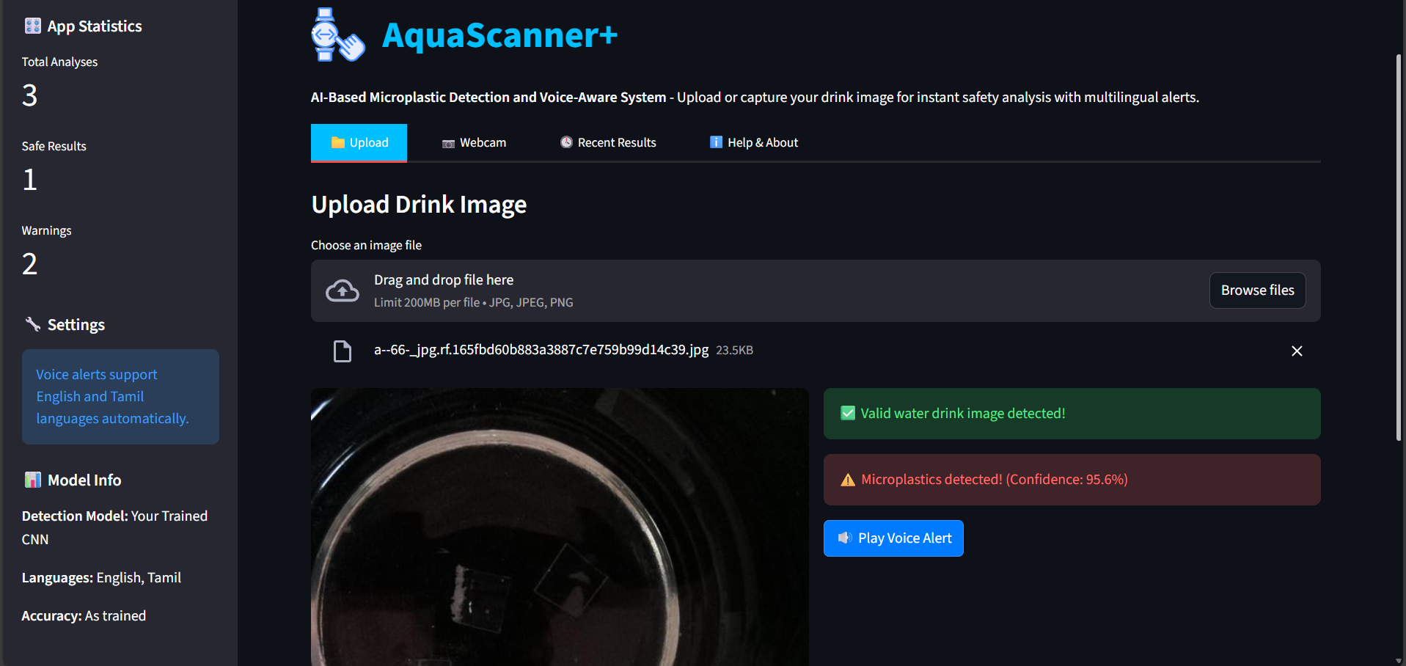
PREDICTED SAMPLE OUTPUT

Slide 18

CONCLUSION & FUTURE SCOPE
CONCLUSION: Our AI microplastic detector offers fast, accurate, and accessible water quality monitoring with voice alerts, empowering users to take timely action.
NEXT STEPS:
Add geo-mapping and pollution tracking
Detect other contaminants beyond microplastics.
Develop mobile app for wider use.
Localized Automated Voice Input.
Eco reward system.
Collaborate with environmental agencies and NGOs.
Publish research and explore patenting.

Slide 19

REFERENCES
Venkatesh, Z., Subashini, M. S., Nallathambi, C. (2023). Smartphone-Based Microplastic Detection System using Cloud-Based Deep Learning Service. Sensors and Actuators A Physical, 350, 114-123.
Mehta, R., Basu, A., Raman, K. (2023). Automated Microplastic Detection in Aquatic Environments using Deep Learning. Proceedings of the IEEE International Conference on Image Processing.
Praveen Kumar, K., Saravanan, S. (2023). Microplastics Detection using Image Processing Techniques: A Comprehensive Review. Environmental Science Technology, 578, 12345-12356.
Liu, Y., Wu, J., Zhang, L. (2024). A Hybrid CNN-Transformer Model for Microplastic Segmentation in Water Imagery. Journal of Environmental Informatics, 382, 2024.
Martinez, E., Lee, F., Chandra, T. (2024). Challenges and Prospects in Deep Learning-Based Microplastics Detection. Ecological Indicators, 156, 110531.

Slide 20
THANK YOU

